Slide 1
Presentation about php ,mysql and apis

Slide 2
Introduction of php
What is PHP?
PHP (Hypertext Preprocessor) is a widely used, open-source scripting language designed for web development. It runs on the server side, meaning that the PHP code is executed on the server, and the result is sent to the user's browser as HTML.
Key Features of PHP
– Easily connects with databaseServer-side Execution – PHP scripts run on a web server before being sent to the client.
Embedded in HTML – PHP can be embedded within HTML code.
Cross-Platform – Works on different operating systems (Windows, Linux, macOS).
Open-Source – Free to use and supported by a large community.
Database Integration s like MySQL, Postgre

Slide 3
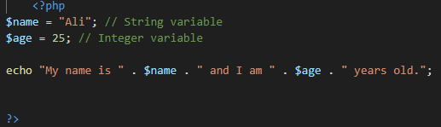
1:variables
A variable in PHP is a container used to store data, such as numbers, text, or arrays.
It allows you to store information that can be used and modified throughout your script.
My name is Ali and I am 25 years old.

Slide 4
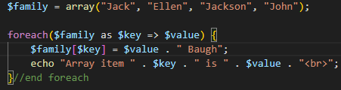
2:array in php
An array in PHP is a special variable that can hold multiple values in a single variable. Instead of storing multiple variables separately, an array allows us to store them together in an organized way.
Types of Arrays in PHP
PHP has three main types of arrays:
Indexed Arrays – Arrays with numeric keys (default).
Associative Arrays – Arrays with named keys.
Multidimensional Arrays – Arrays containing other arrays.
Array item 0 is Jack
Array item 1 is Ellen
Array item 2 is Jackson
Array item 3 is John

Slide 5
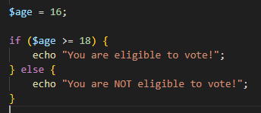
3:If statement
An if statement in PHP is used to execute code only if a certain condition is true.
It helps in decision-making within a program.
if (condition) {
// Code to execute if the condition is TRUE
}
You are NOT eligible to vote!

Slide 6

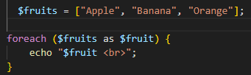
4:for and foreach loop
1. for Loop
The for loop is used when we know exactly how many times we want to repeat an action.
for loop: Number: 1
Number: 2
Number:3
Number: 4
2. foreach Loop Number: 5
The foreach loop is used only for arrays.
It loops through each element of an array automatically,
without needing a counter.
Apple
Banana
Orange

Slide 7
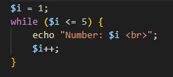
5:while loop
The while loop in PHP executes a block of code repeatedly as long as a specified condition remains true.
It's useful when we don’t know exactly how many times the loop should run but we have a condition to check.
Sytax:
while (condition) {
// Code to execute
}
Number: 1
Number: 2
Number: 3
Number: 4
Number: 5

Slide 8
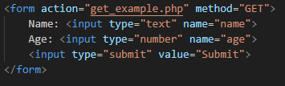
6:get method($_get)
The GET method sends data through the URL, making it visible to users.
It is commonly used for:
✅ Search queries (e.g., Google searches)
✅ Filtering content (e.g., ?category=phones)
✅ Passing small amounts of non-sensitive data
How GET Works:
The form data is appended to the URL after a ? symbol.
Each input field is sent as key=value.
Multiple values are separated by &.
When submitted, the URL will look like:
get_example.php?name=Ali&age=25

Slide 9
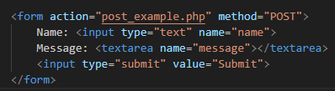
7. POST Method ($_POST)
The POST method sends data securely in the background, without displaying it in the URL.
It is commonly used for:
✅ User login forms
✅ Submitting comments or messages
✅ Sending large data
How POST Works:
Data is sent inside the request body, not in the URL.
It does not have a length limit (can send more data than GET).
It is more secure than GET (but still needs validation).
URL stays clean (no ?name=Ali&message=Hello in the address bar).

